Slide 1
Automated data analysis for high-dimensional cytometry experiments
Felix J. Hartmann

Slide 2
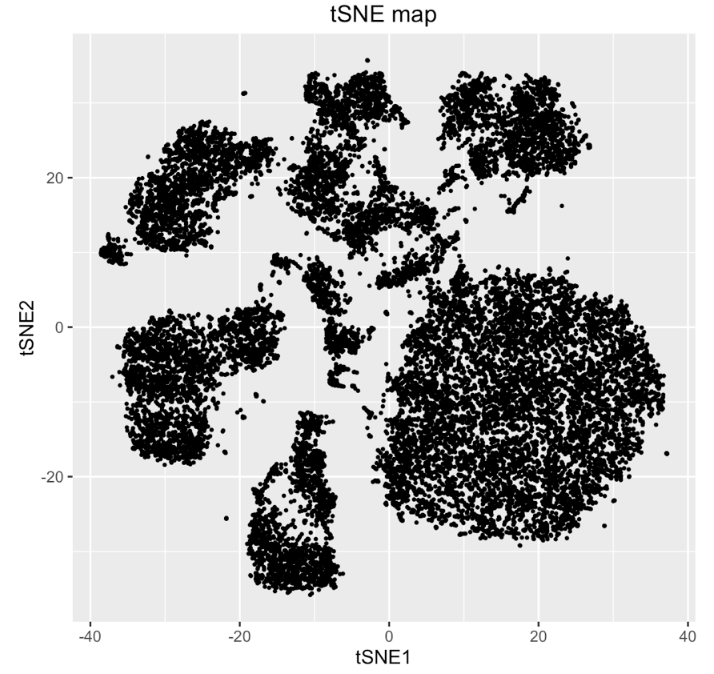
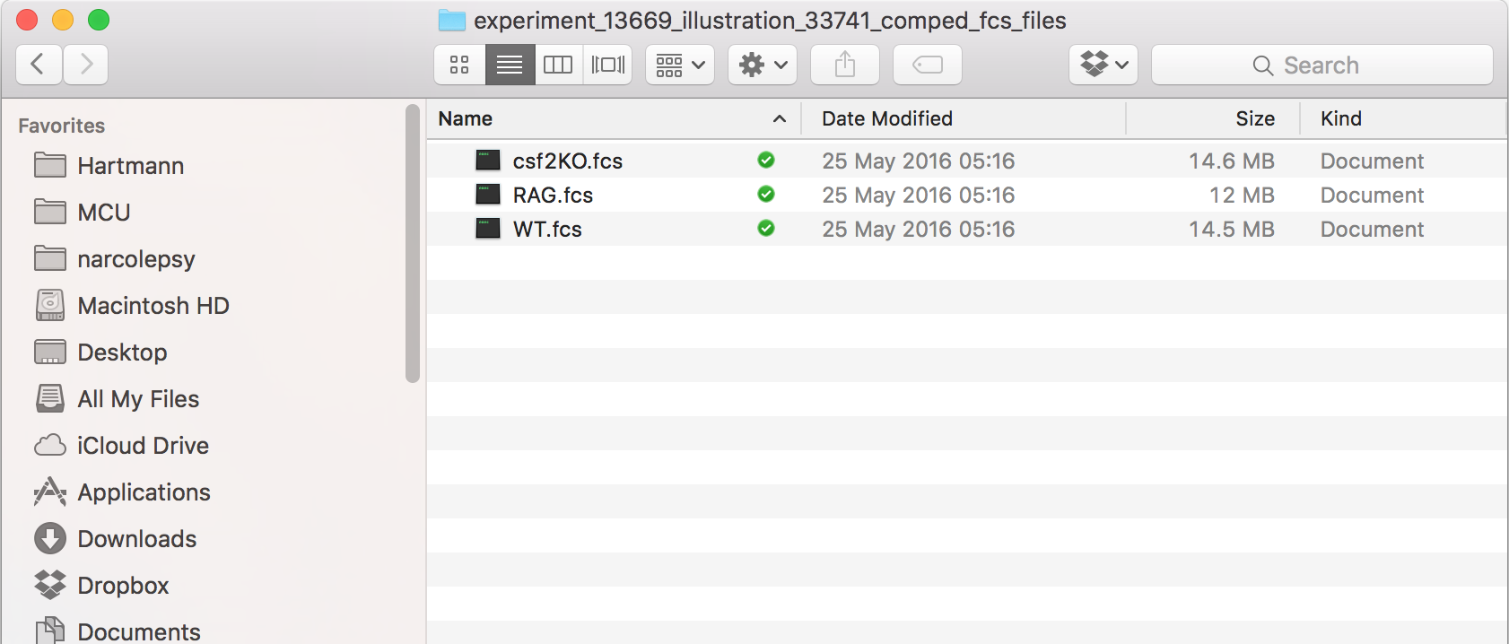
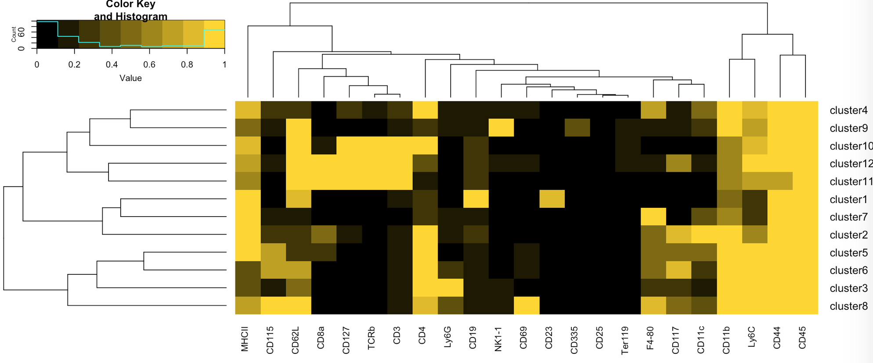
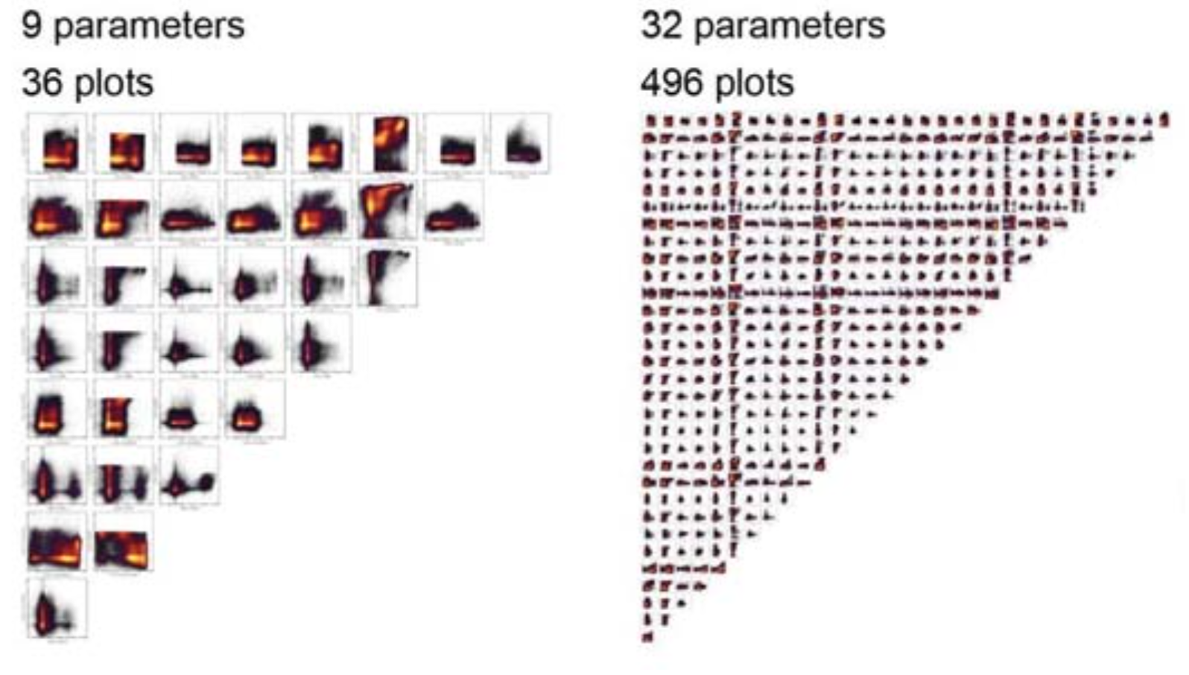
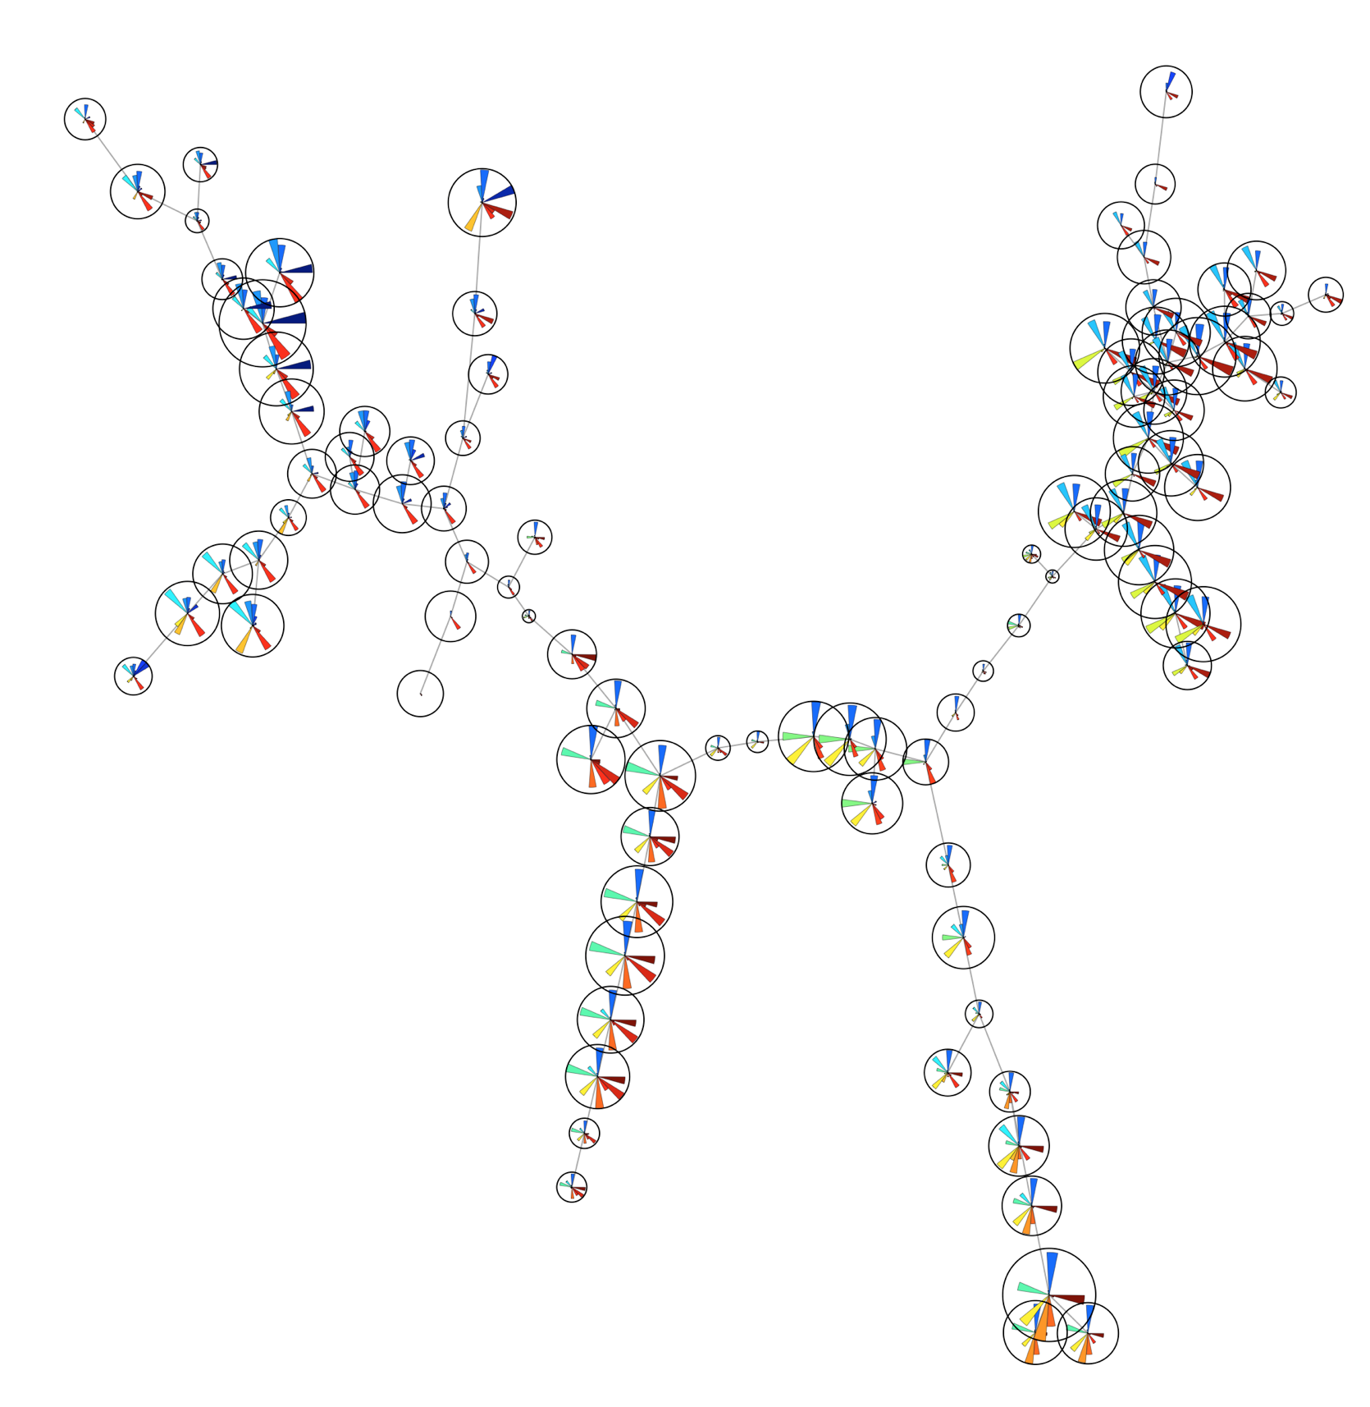
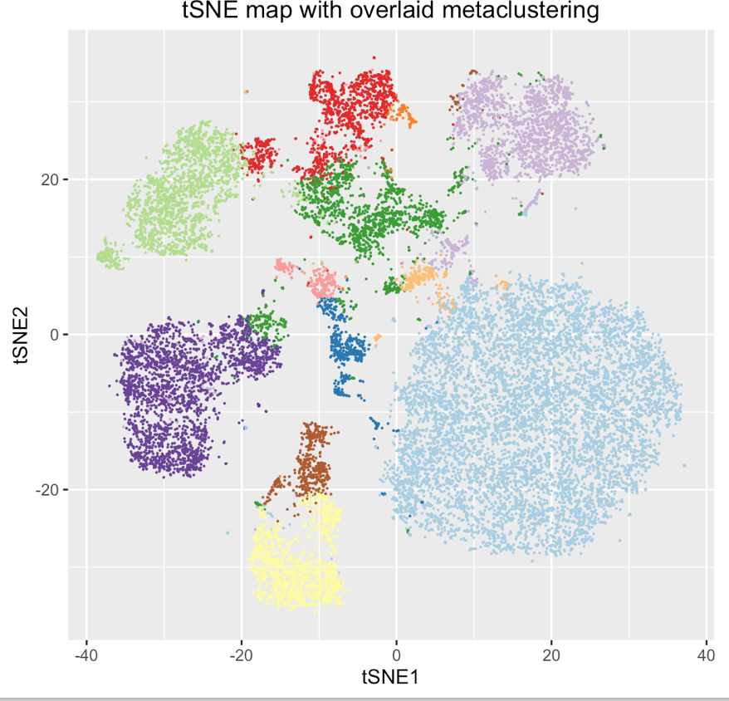
Motivation

Slide 3
Program outline
Data pre-processing for automated data analysis
Data transformation
Data normalization
Short introduction to advanced data analysis algorithms
t-stochastic neighbor embedding (t-SNE, viSNE, bhSNE, …)
FlowSOM clustering for population identification
Address remaining questions in handling cytobank
Data analysis using the R software package

Slide 4
Data transformation

Slide 5
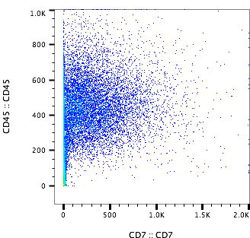
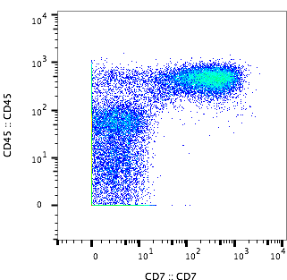
Data transformation
Epitope abundances measured by cytometry often follow normal distributions on a logarithmic scale (so called log-normal distribution) with the variance of different cell populations depending on their intensity.
Obtaining a suitable representation of the data across its entire intensity range is crucial for visualization and particularly for automated analysis.
Linear scale
arcsinh scale
Reviewed in:
Trotter J. Alternatives to log-scale data display. Curr Protoc Cytom. 2007; Chapter 10:Unit10.16–10.16.11.
Finak G, Perez J-M, Weng A, Gottardo R. Optimizing transformations for automated, high throughput analysis of flow cytometry data. BMC Bioinformatics. 2010; 11:546.

Slide 6
Data transformation
In practice, cytometry data is frequently transformed using an logicle or arcsinh transformation.
Common co-factors for arcsinh transformations are
Flow cytometry data: 150
Mass cytometry data: 5
Functions to perform such data transformations are commonly integrated into the respective analysis tools (R packages, cyt, Cytobank, ACCENSE).

Slide 7
Data normalization

Slide 8
Normalization
What is normalization
A form of standardization..
Process of using internal or external control values to express acquired data on a common scale
Thus improves comparability between samples (different days, different machines) or also different channels/antigens.

Slide 9
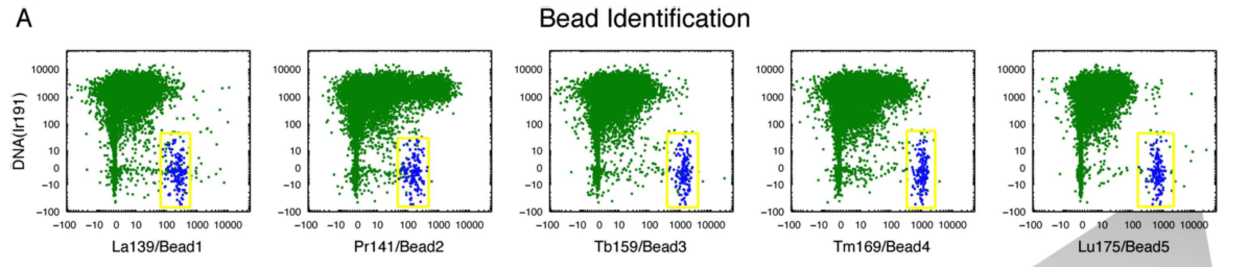
Which control values can be used?
1. Bead normalization
Beads with known intensity can be acquired together (or before) with cells
The measured intensities can be used to normalize towards instrument behavior, accounting for different sensitivity etc. of the instrument on different days
R. Finck, E. F. Simonds, A. Jager, S. Krishnaswamy, K. Sachs, W. Fantl, D. Pe’er, G. P. Nolan, S. C. Bendall, Normalization of mass cytometry data with bead standards., Cytometry. A 83, 483–94 (2013).

Slide 10
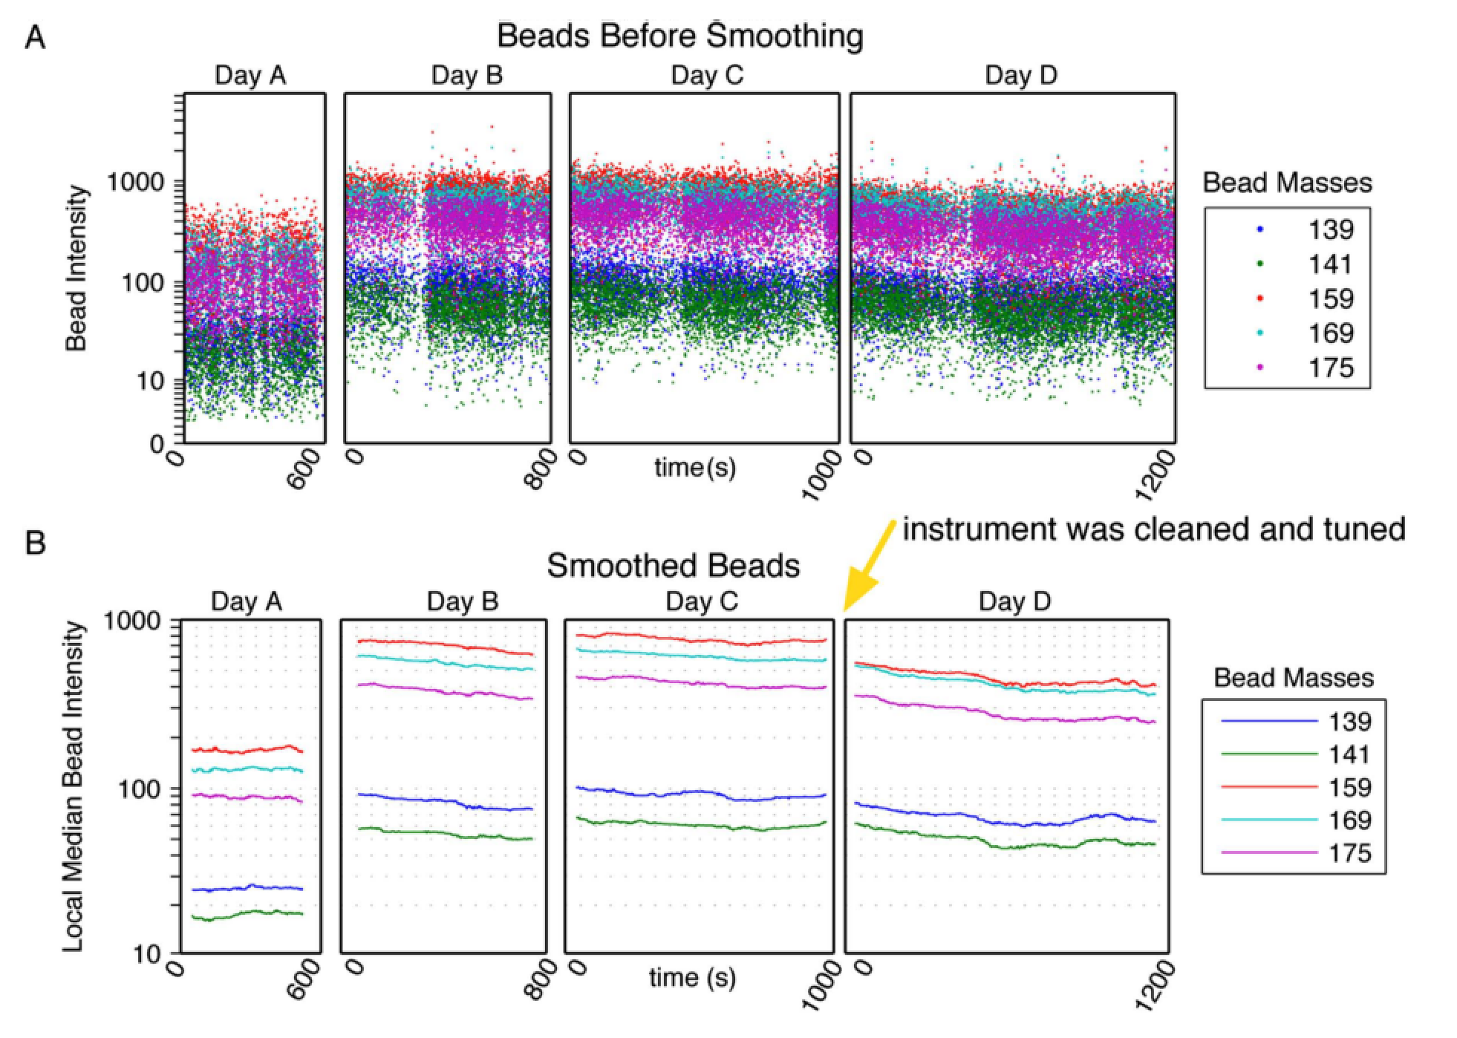
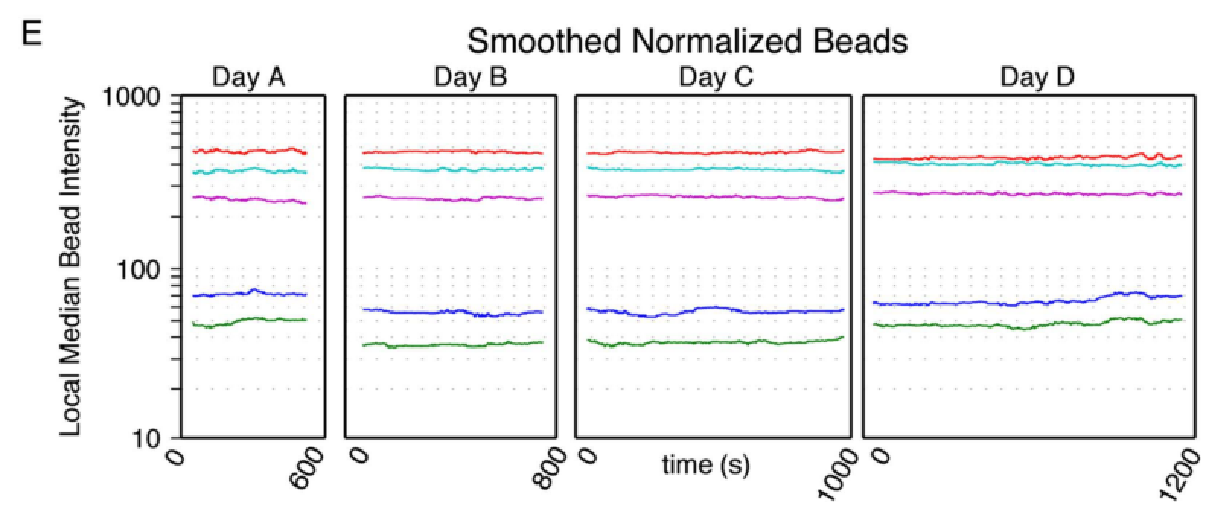
Bead normalization
R. Finck, E. F. Simonds, A. Jager, S. Krishnaswamy, K. Sachs, W. Fantl, D. Pe’er, G. P. Nolan, S. C. Bendall, Normalization of mass cytometry data with bead standards., Cytometry. A 83, 483–94 (2013).

Slide 11
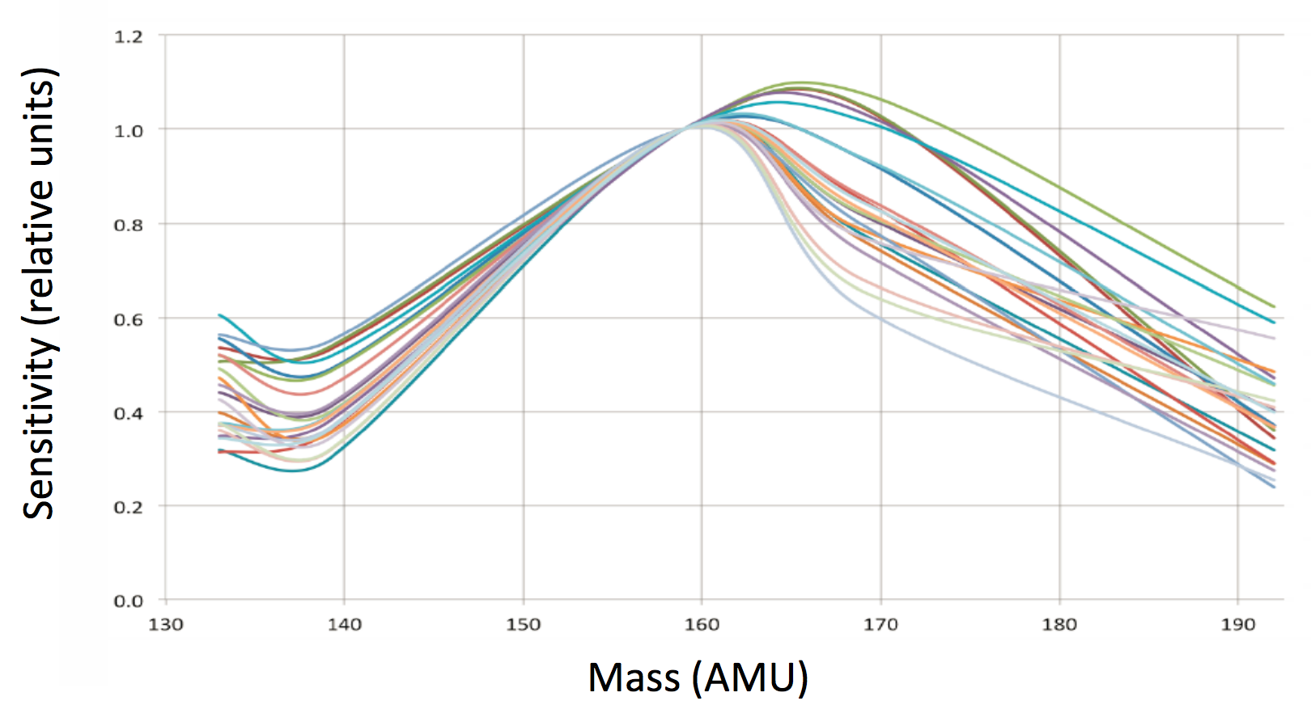
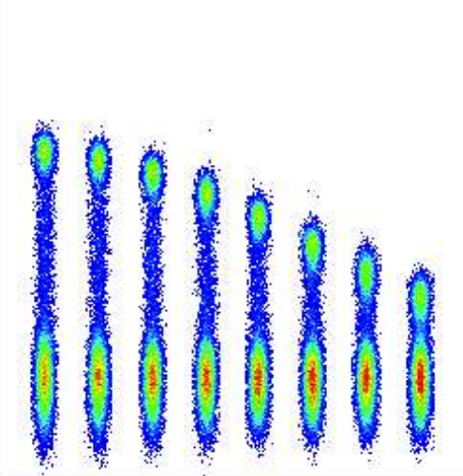
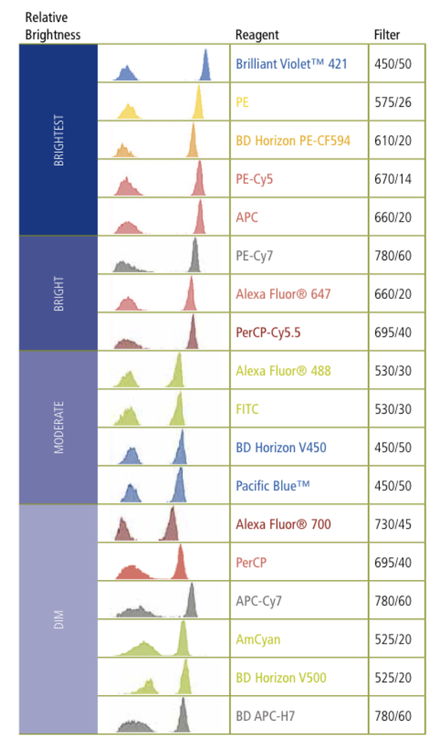
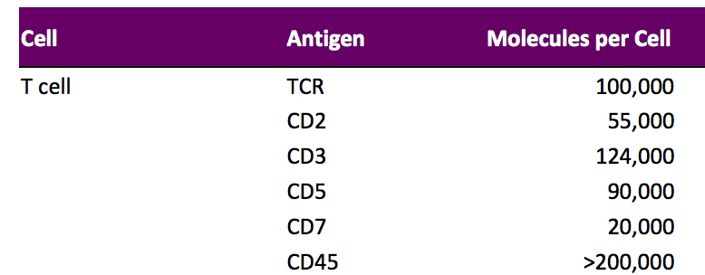
Channel-specific normalization
Different markers/antibodies/channels have different dynamic ranges
Differences could be due to:
Detector sensitivity
Fluorochrome brightness
Antibody concentration
Clone performance
Epitope expression level

Slide 12
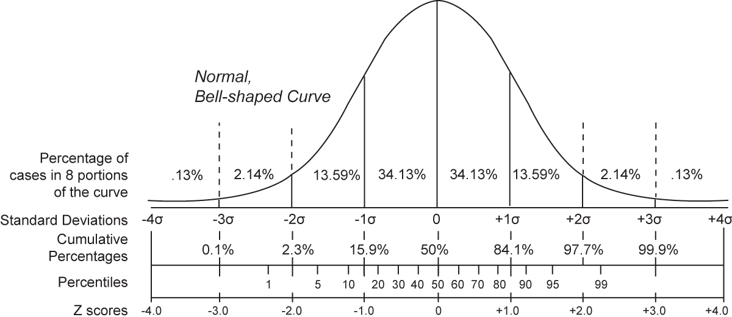
Channel-specific normalization
Channel specific normalization methods
z-Score normalization
Expresses the data as standard deviations above or below the mean
wikipedia
Percentile normalization
Expresses the data as a fraction of the percentile
E.g. 100 Percentile → cell with highest expression level is set to 1

Slide 13
Percentile normalization
99th percentile of MHCII (6.7)
 | CD3 | CD4 | CD8
Cell_1 | 8 | 0 | 12
Cell_2 | 10 | 6 | 1
99th percentile of CD19 (3.9)

Slide 14
Percentile normalization
Before percentile normalization
After percentile normalization
4
1
0
0
0
1.5
0
1

Slide 15
Algorithms for data analysis

Slide 16
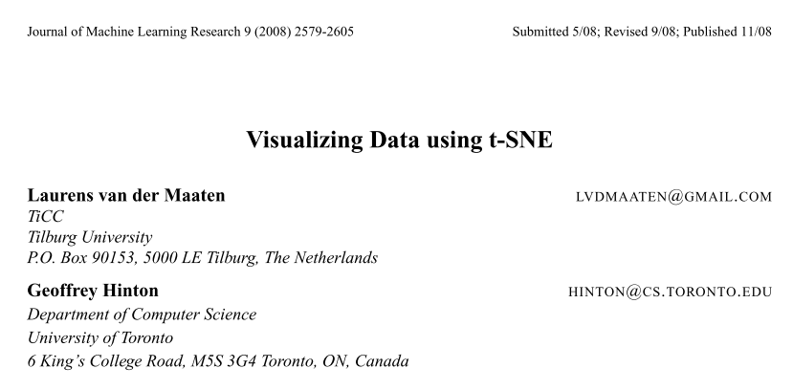
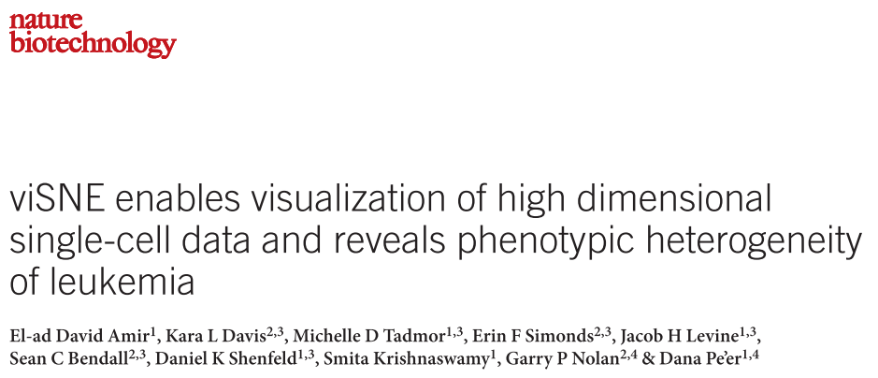
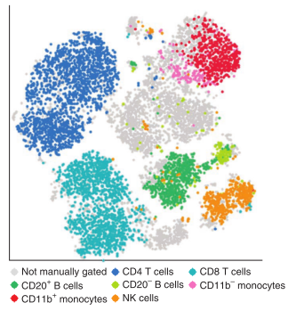
Visualization with t-SNE

Slide 17
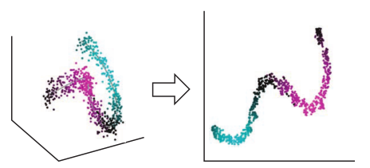
t-SNE
t-SNE visualizes high-dimensional similarities of cells in an easily understandable two- or three-dimensional scatter plot, the so-called t-SNE map.
The proximity of cells in the t-SNE map reflects their distances in the high-dimensional space

Slide 18
t-SNE
Cells that are similar in their analyzed protein-expression pattern will be located closely together in the t-SNE map, thus enabling the visualization of different cellular subpopulations

Slide 19
t-SNE
Algorithm
Calculation of a pairwise similarity matrix based on the high-dimensional distances
Next, a low-dimensionality similarity matrix is calculated based on initially random locations for each cell in the two (or three) t-SNE dimensions
In an iterative process, the algorithm then tries to minimize the difference between the high- and low-dimensional similarity matrices, thereby adjusting every cell ́s position in the two-dimensional space
Recent improvements make use of the Barnes-Hut algorithm using a tree-like structure to reduce the number of pairwise similarities that actually have to be calculated

Slide 20
tSNE step 1
High-dimensional distances
1
 | Cell_1 | Cell_2 | Cell_3
Cell_1 | 8
Cell_2
0
0
1

Slide 21
tSNE step 2
Low dimensional distances
1
 | Cell_1 | Cell_2 | Cell_3
Cell_1
Cell_2
0
0
1

Slide 22
tSNE step 3
1
 | Cell_1 | Cell_2 | Cell_3
Cell_1
Cell_2
Compare the two distances matrices
 | Cell_1 | Cell_2 | Cell_3
Cell_1
Cell_2
0
0
1

Slide 23
tSNE final
1
 | CD3 | CD4 | CD8 | tSNE1 | tSNE2
Cell_1 | 8 | 0 | 12 | -12 | 12
Cell_2 | 10 | 6 | 1 | 35 | 1
0
0
1

Slide 24
t-SNE
Notes
On the resulting t-SNE map, different immune subpopulations will visually appear as distinct clusters, however t-SNE does not per se assign single cells to defined clusters.
t-SNE incorporates random seeds and thus results from multiple runs visualize the data differently.
There are plenty of t-SNE implementations (R, cytobank, matlab/cyt, ACCENSE, …)

Slide 25
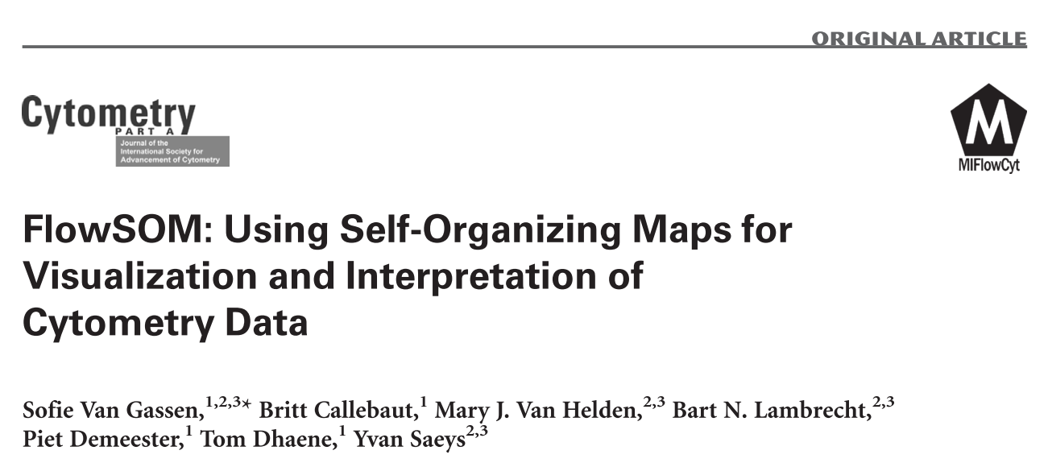
FlowSOM clustering

Slide 26
FlowSOM
Why FlowSOM?
While t-SNE visualizes phenotypically similar cell subsets in high-dimensional datasets, it does not directly assign cells to distinct clusters
FlowSOM is very fast, convenient to use (in R) and produces results which fit nicely with expected populations

Slide 27
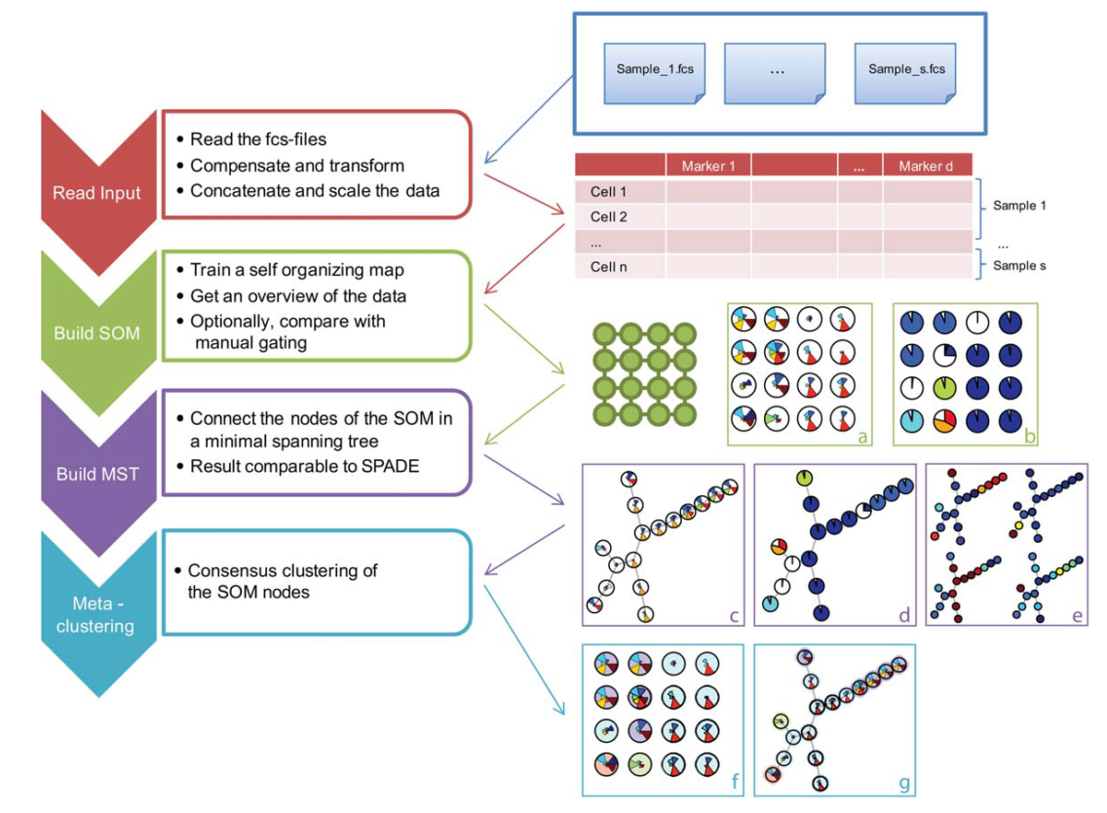
FlowSOM

Slide 28
Self-organizing maps
Wikipedia.org
The blue blob is the distribution of the training data, and the small white disc is the current training datum drawn from that distribution.
At first (left) the SOM nodes are arbitrarily positioned in the data space. The node (highlighted in yellow) which is nearest to the training datum is selected. It is moved towards the training datum, as (to a lesser extent) are its neighbors on the grid.
After many iterations the grid tends to approximate the data distribution (right).

Slide 29
Metaclustering of nodes

Slide 30
FlowSOM output
FlowSOM assignes every cell to a node which is eventually merged into a metacluster
 | CD3 | CD4 | CD8 | Metacluster_identity
Cell_1 | 8 | 0 | 12 | 1
Cell_2 | 10 | 6 | 1 | 5

Slide 31
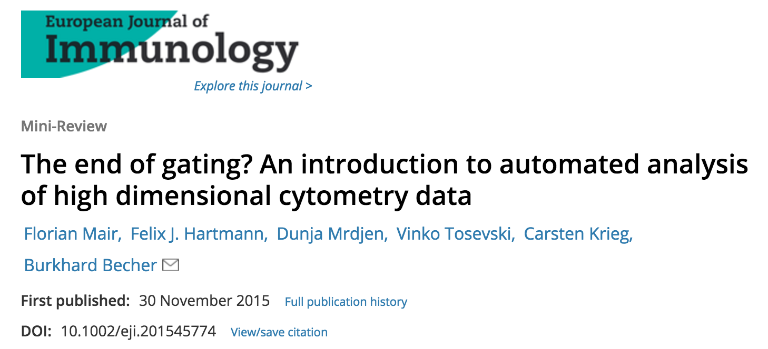
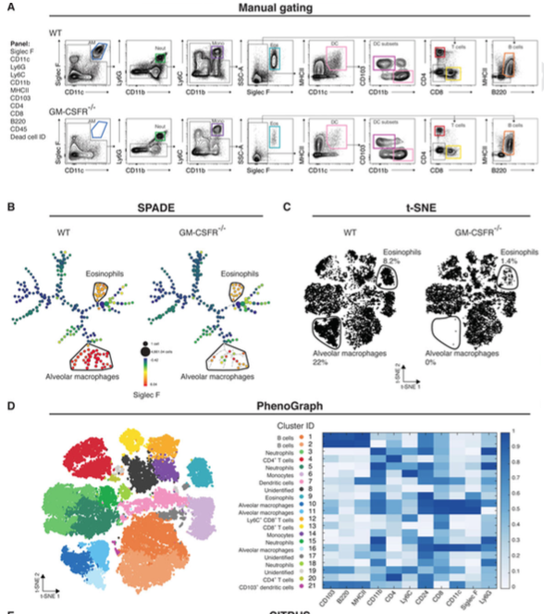

Slide 32
Practical part

Slide 33
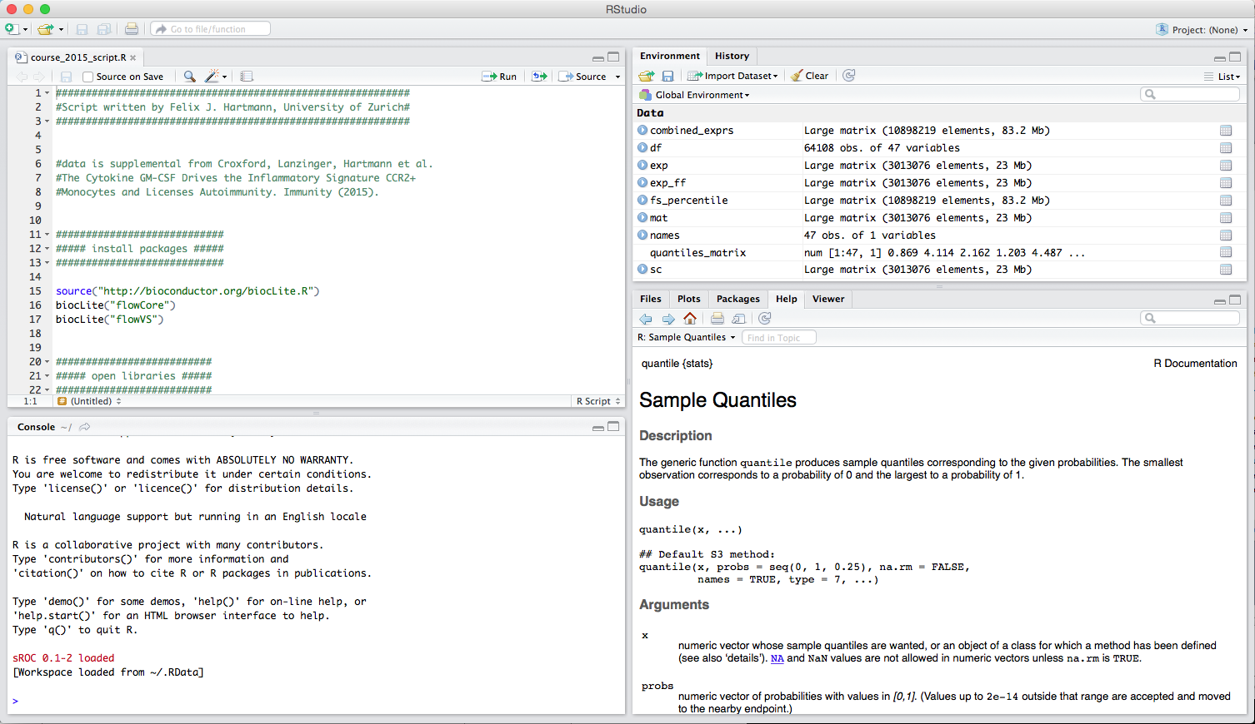
R studio
Script
Variables
Plots, help
Console

Slide 34
Cytometry data in R
one flowframe = one fcs file
one flowSet = multiple fcs files
@exprs
@parameters
@description

Slide 35
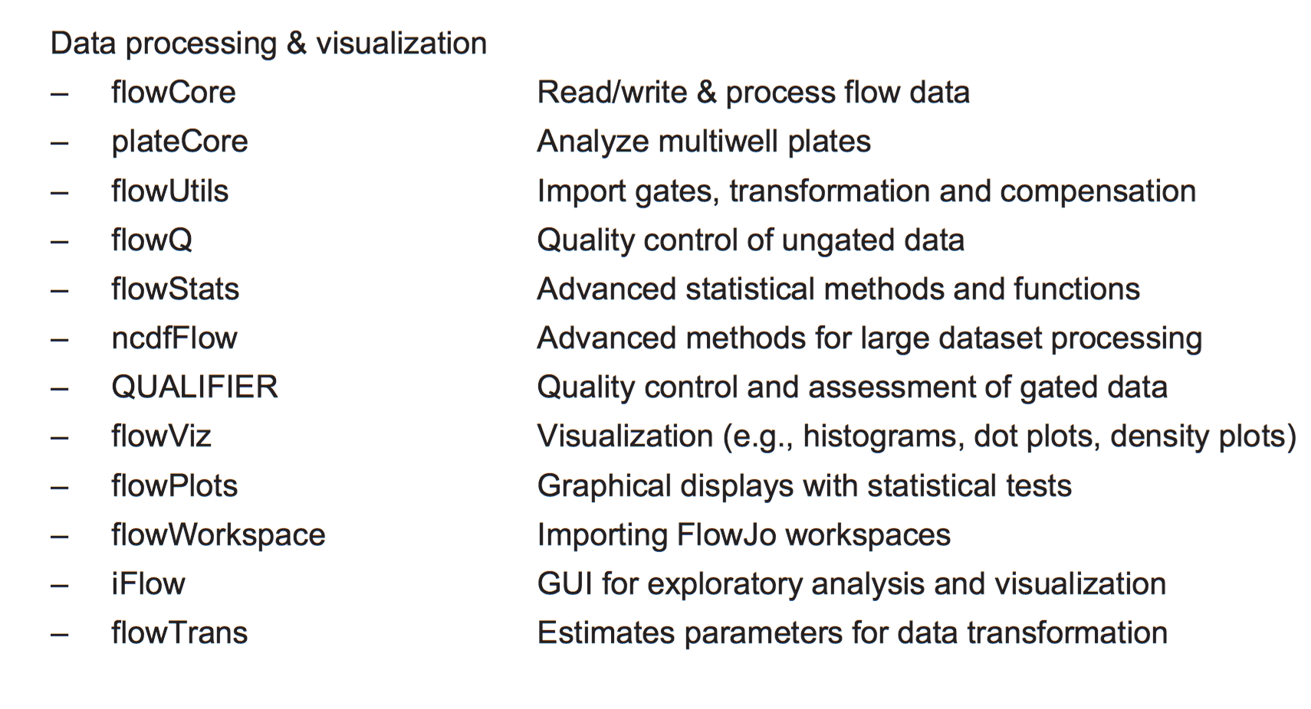
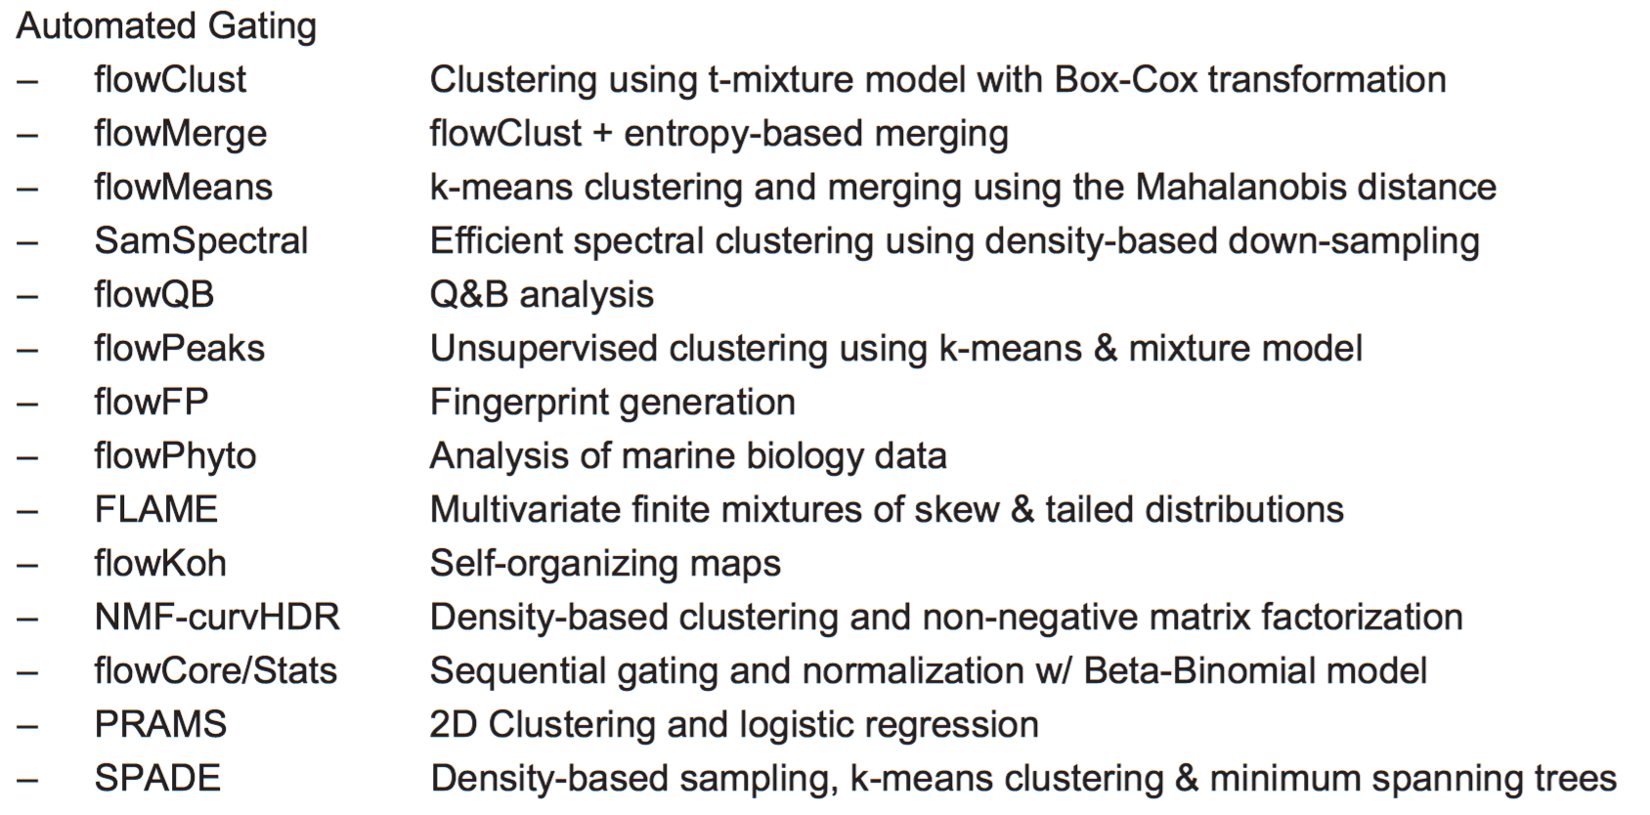
R packages for flow analysis

Slide 36
Combining data into one object
data
# combine data into a matrix
data <- fsApply(fs, exprs)
# make a gate.source vector
fs_rows <- fsApply(fs, nrow)
# repeat the indices
gate.source <- as.vector(x = NULL)
for(i in 1:length(dim.vec)) {
temp.source <- rep(i, dim.vec[i])
gate.source <- c(gate.source, temp.source)
}
# bind it to the data
data <- cbind(data, gate.source)head(data)
@exprs_1
1
1
1
1
2
2
2
2
2
2
3
3
3
3
@exprs_2
@exprs_3

Slide 37
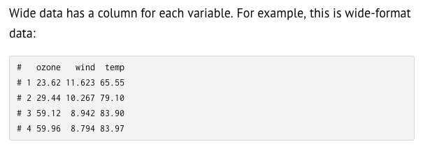
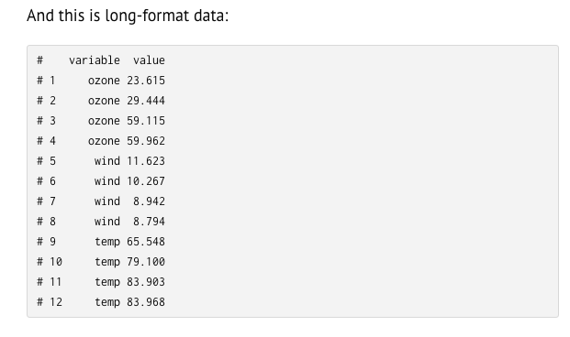
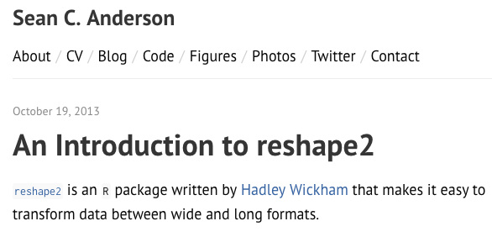
The tidy data concept in R

Slide 38
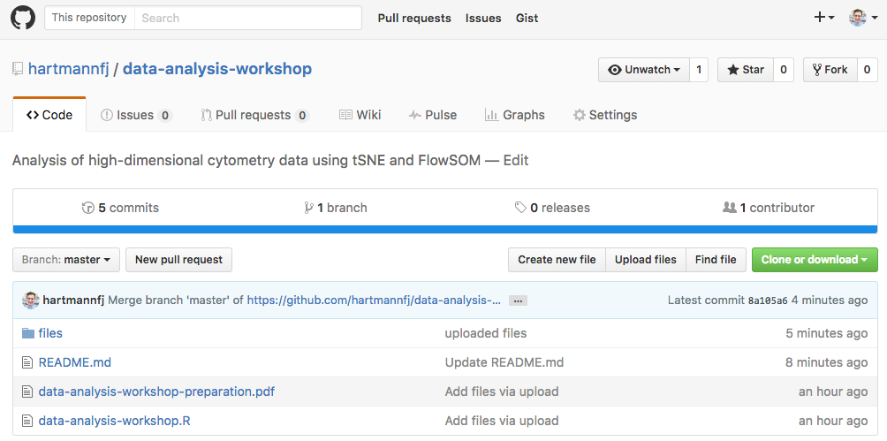
Find this workshop online
Uploaded this presentation, the script as well as the files onto a github repository
https://github.com/hartmannfj/data-analysis-lab

